Slide 1
Getting Real with VBA (day 3)
Nick Anderson

Slide 2
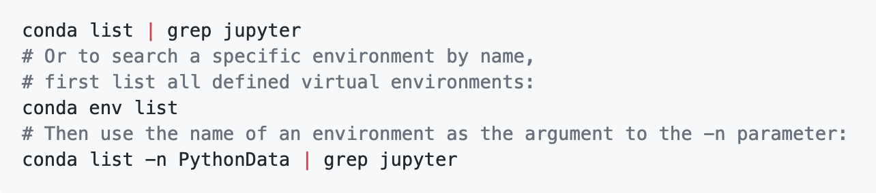
Verify Conda + Python Overview (intro ppt)

Slide 3
Stars Counter (your turn, 15 min.)
Create a VBA Script that tallies the number of "Full Stars" per row and enters them into the Total column.
Hint 1: You will need to use a nested for loop.
Hint 2: You will need to create a variable to hold the number of stars and continually reset this variable at the start of each row.

Slide 4
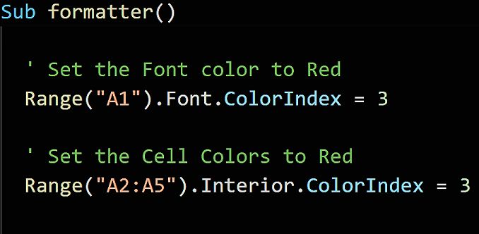
VBA Formatting

Slide 5
VBA Formatting
Tell me the ColorIndex for Green, Blue and Magenta. See link below. http://dmcritchie.mvps.org/excel/colors.htm

Slide 6
VBA Gradebook (your turn, 15 min.)

Slide 7
VBA Gradebook (your turn, 15 min.)
Abov 90, show "A", and filled green with the text "Pass"
80 and 89 (inclusive), show "B", filled green with the text "Pass"
70 and 79 (inclusive), show "C", filled yellow with the text "Warning"
Below 70, show "F", filled red with the text "Fail"
Bonus: second button that resets to the original state and previous grade in a row labeled "Last Grade"

Slide 8
Checkerboard (partner up, 15 min.)

Slide 9
Checkerboard (partner up, 15 min.)
Using VBA scripting, create an 8x8 grid with alternating red and black squares.
You will need to use nested for loops, conditionals, mods, and formatting to create the board.
Hint: try creating one row, then try creating the next row.

Slide 10
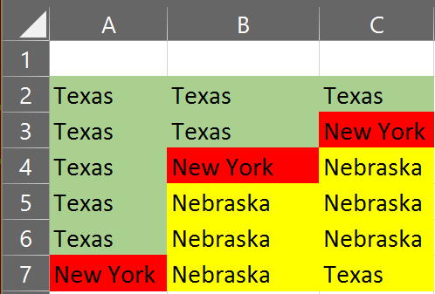
Looking to the Next Cell

Slide 11
Card Checker (your turn, 15 min.)

Slide 12
Card Checker (your turn, 15 min.)
Create a VBA script that will process the credit card purchases, identifying each of the unique brands listed.
For the Basic assignment, create a single pop-up message for each of the Credit Card brands listed by looping through the list.
For the Advanced assignment, tally the total credit card purchases for each Credit Card brand and add it to the summary table.

Slide 13
Break (15 minutes)

Slide 14
Wells Fargo - Part I (group, 30 min.)

Slide 15
Wells Fargo - Part I (group, 30 min.)
Extract words before the phrase "_Wells_Fargo" to figure out which State.
Add the State to the first column of each spreadsheet.
Convert the headers of each row to simply say the year.
Convert the numbers to currency values for all cells

Slide 16
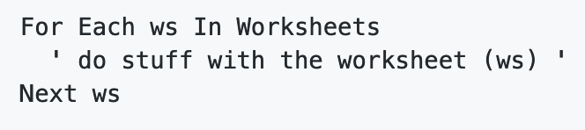
Wells Fargo - Part I (group, 30 min.)
Use For Each loop: to loop over each worksheet
First work on getting the correct formatting on one sheet before moving onto creating a loop that formats each sheet within your workbook.
For a useful worksheet example, click HERE

Slide 17
Wells Fargo - Part II (group, 30 min.)

Slide 18
Wells Fargo - Part II (group, 30 min.)
Loop through every worksheet and select the state contents.
Copy the state contents and paste it into the Combined_Data tab
Hint 1: remember to create a combined worksheet first, then add the rows to the combined worksheet.
Hint 2: Find the last row in order to properly copy each.

